Slide 1
Racial Bias as a Function of Dataset?
A case study in how demographic distributions affect pulse oximetry
Carmen Bland Jr., Sam Gil, Sydney Seder

Slide 2
Table of Contents
Background and Motivations
Experiment Setup
Results
Conclusion & Future Work

Slide 3
Background
A brief look at the current studies on pulse oximetry and accuracy

Slide 4
How Fingertip Oximeters Work
Transmittance oximetry
Two components to device body:
(1) LED prong
(2) photodetector prong
Red and Infrared (IR) LED light sent through a medium
If:
Blood is well oxygenated, less red light will pass through
Blood is lacking oxygen, less IR light will pass through
1
HbO₂
HbO₂
Hb
Hb
HbO₂
Hb
2
Nitzan, Meir, et al. “Pulse Oximetry: Fundamentals and Technology Update.” Medical Devices (Auckland, N.Z.), vol. 7, July 2014, pp. 231–39. PubMed Central, https://doi.org/10.2147/MDER.S47319.

Slide 5
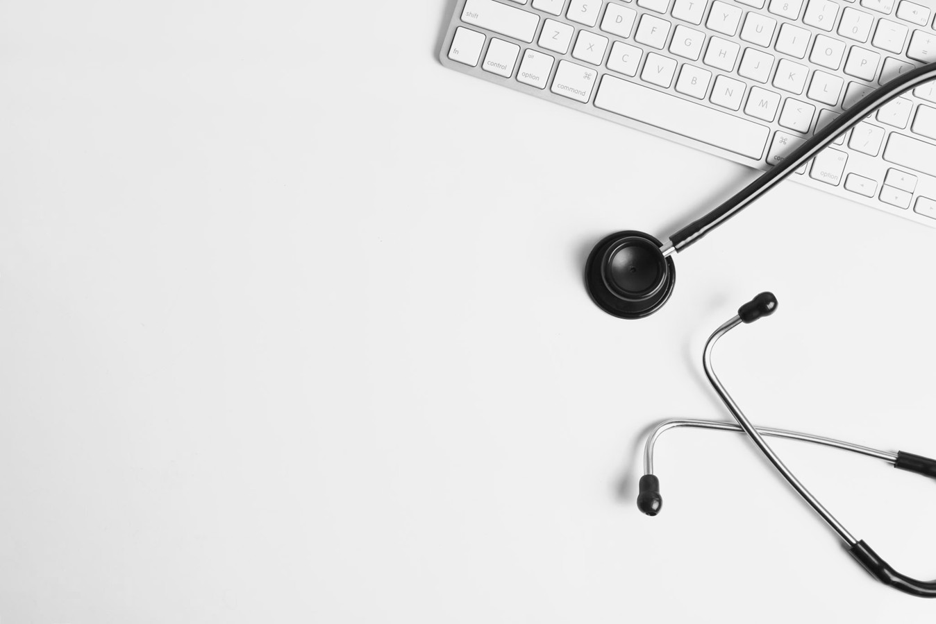




TABLE OF CONTENTS
Background & Motivations
Experiment Setup
Results
Conclusions & Future Work

Slide 6
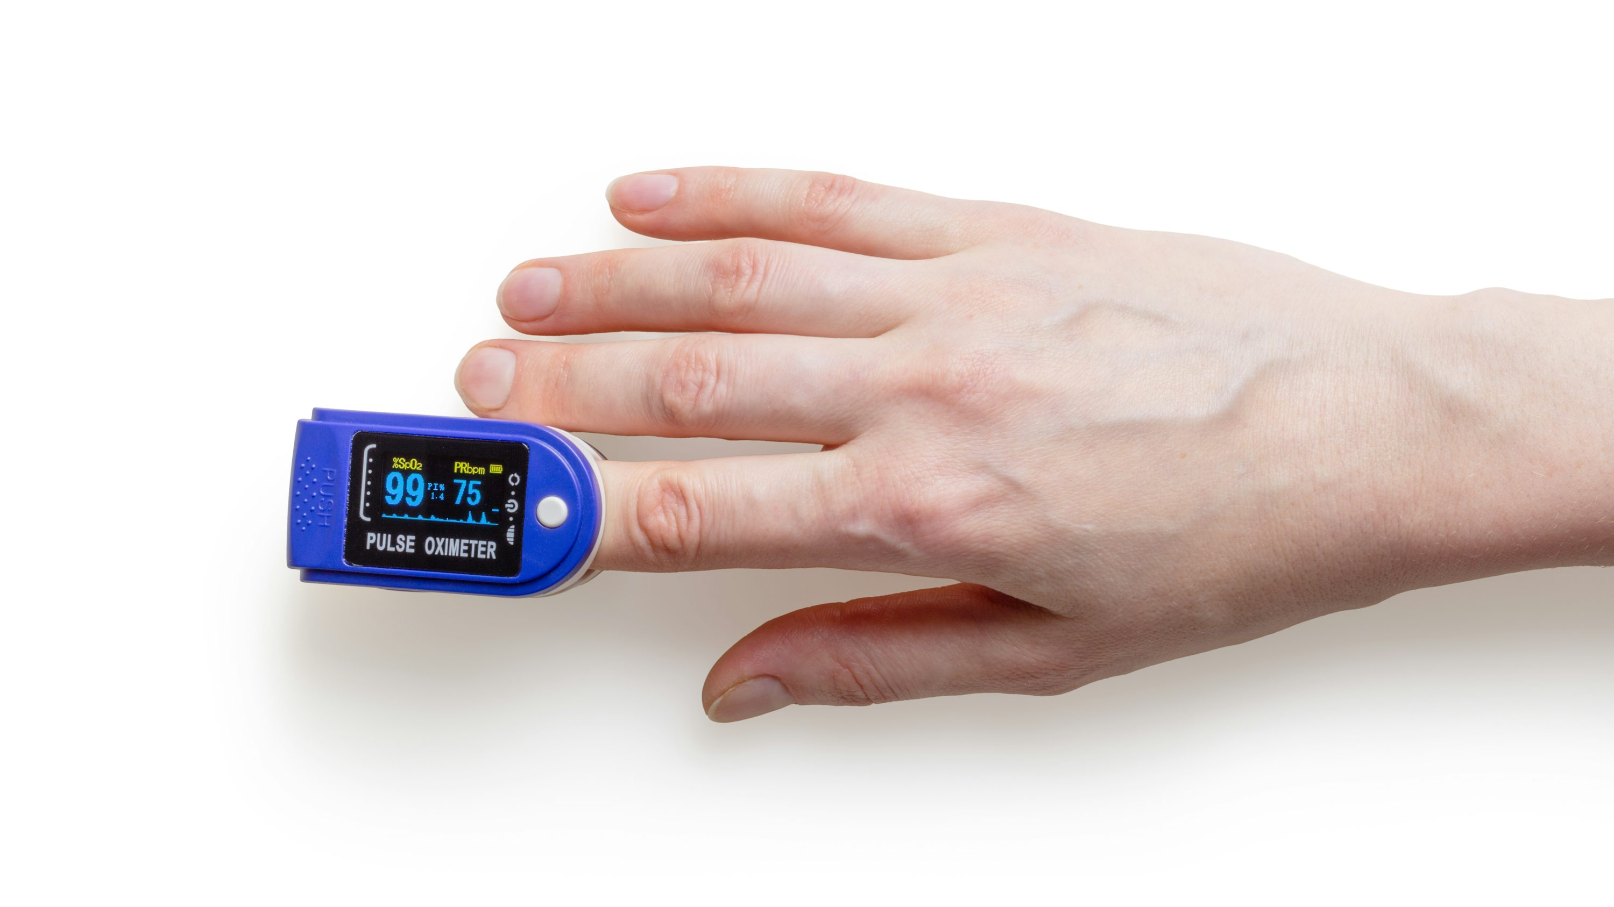
BACKGROUND
A brief look at the current studies on pulse oximetry and accuracy.

Slide 7
How Fingertip Oximeters Work
Transmittance oximetry
Two components to device body:
(1) LED prong
(2) photodetector prong
Red and Infrared (IR) LED light sent through a medium
If:
Blood is well oxygenated, less red light will pass through
Blood is lacking oxygen, less IR light will pass through
1
HbO₂
HbO₂
Hb
Hb
HbO₂
Hb
2
Nitzan, Meir, et al. “Pulse Oximetry: Fundamentals and Technology Update.” Medical Devices (Auckland, N.Z.), vol. 7, July 2014, pp. 231–39. PubMed Central, https://doi.org/10.2147/MDER.S47319.

Slide 8

OpenOximetry Repository
Utilizes data collected by UCSF researchers
One of the aims: more diverse patient distribution
Includes demographic of patients
Assigned sex, race (Monk Scale), ethnicity
Allows for further analysis into demographic effects
Repository comprised of:
6 csv files: bloodgas, devices, patient, etc.
Waveforms: 86 Hz PPG files, 150Hz continuous data, 2Hz Ref Oximeter Readings
Goldberger, A., et al. "PhysioBank, PhysioToolkit, and PhysioNet: Components of a new research resource for complex physiologic signals. Circulation [Online]. 101 (23), pp. e215–e220." (2000).
Fong, Nicholas, et al. "OpenOximetry Repository" (version 1.0.1). PhysioNet (2024), https://doi.org/10.13026/2g7z-t345.

Slide 9
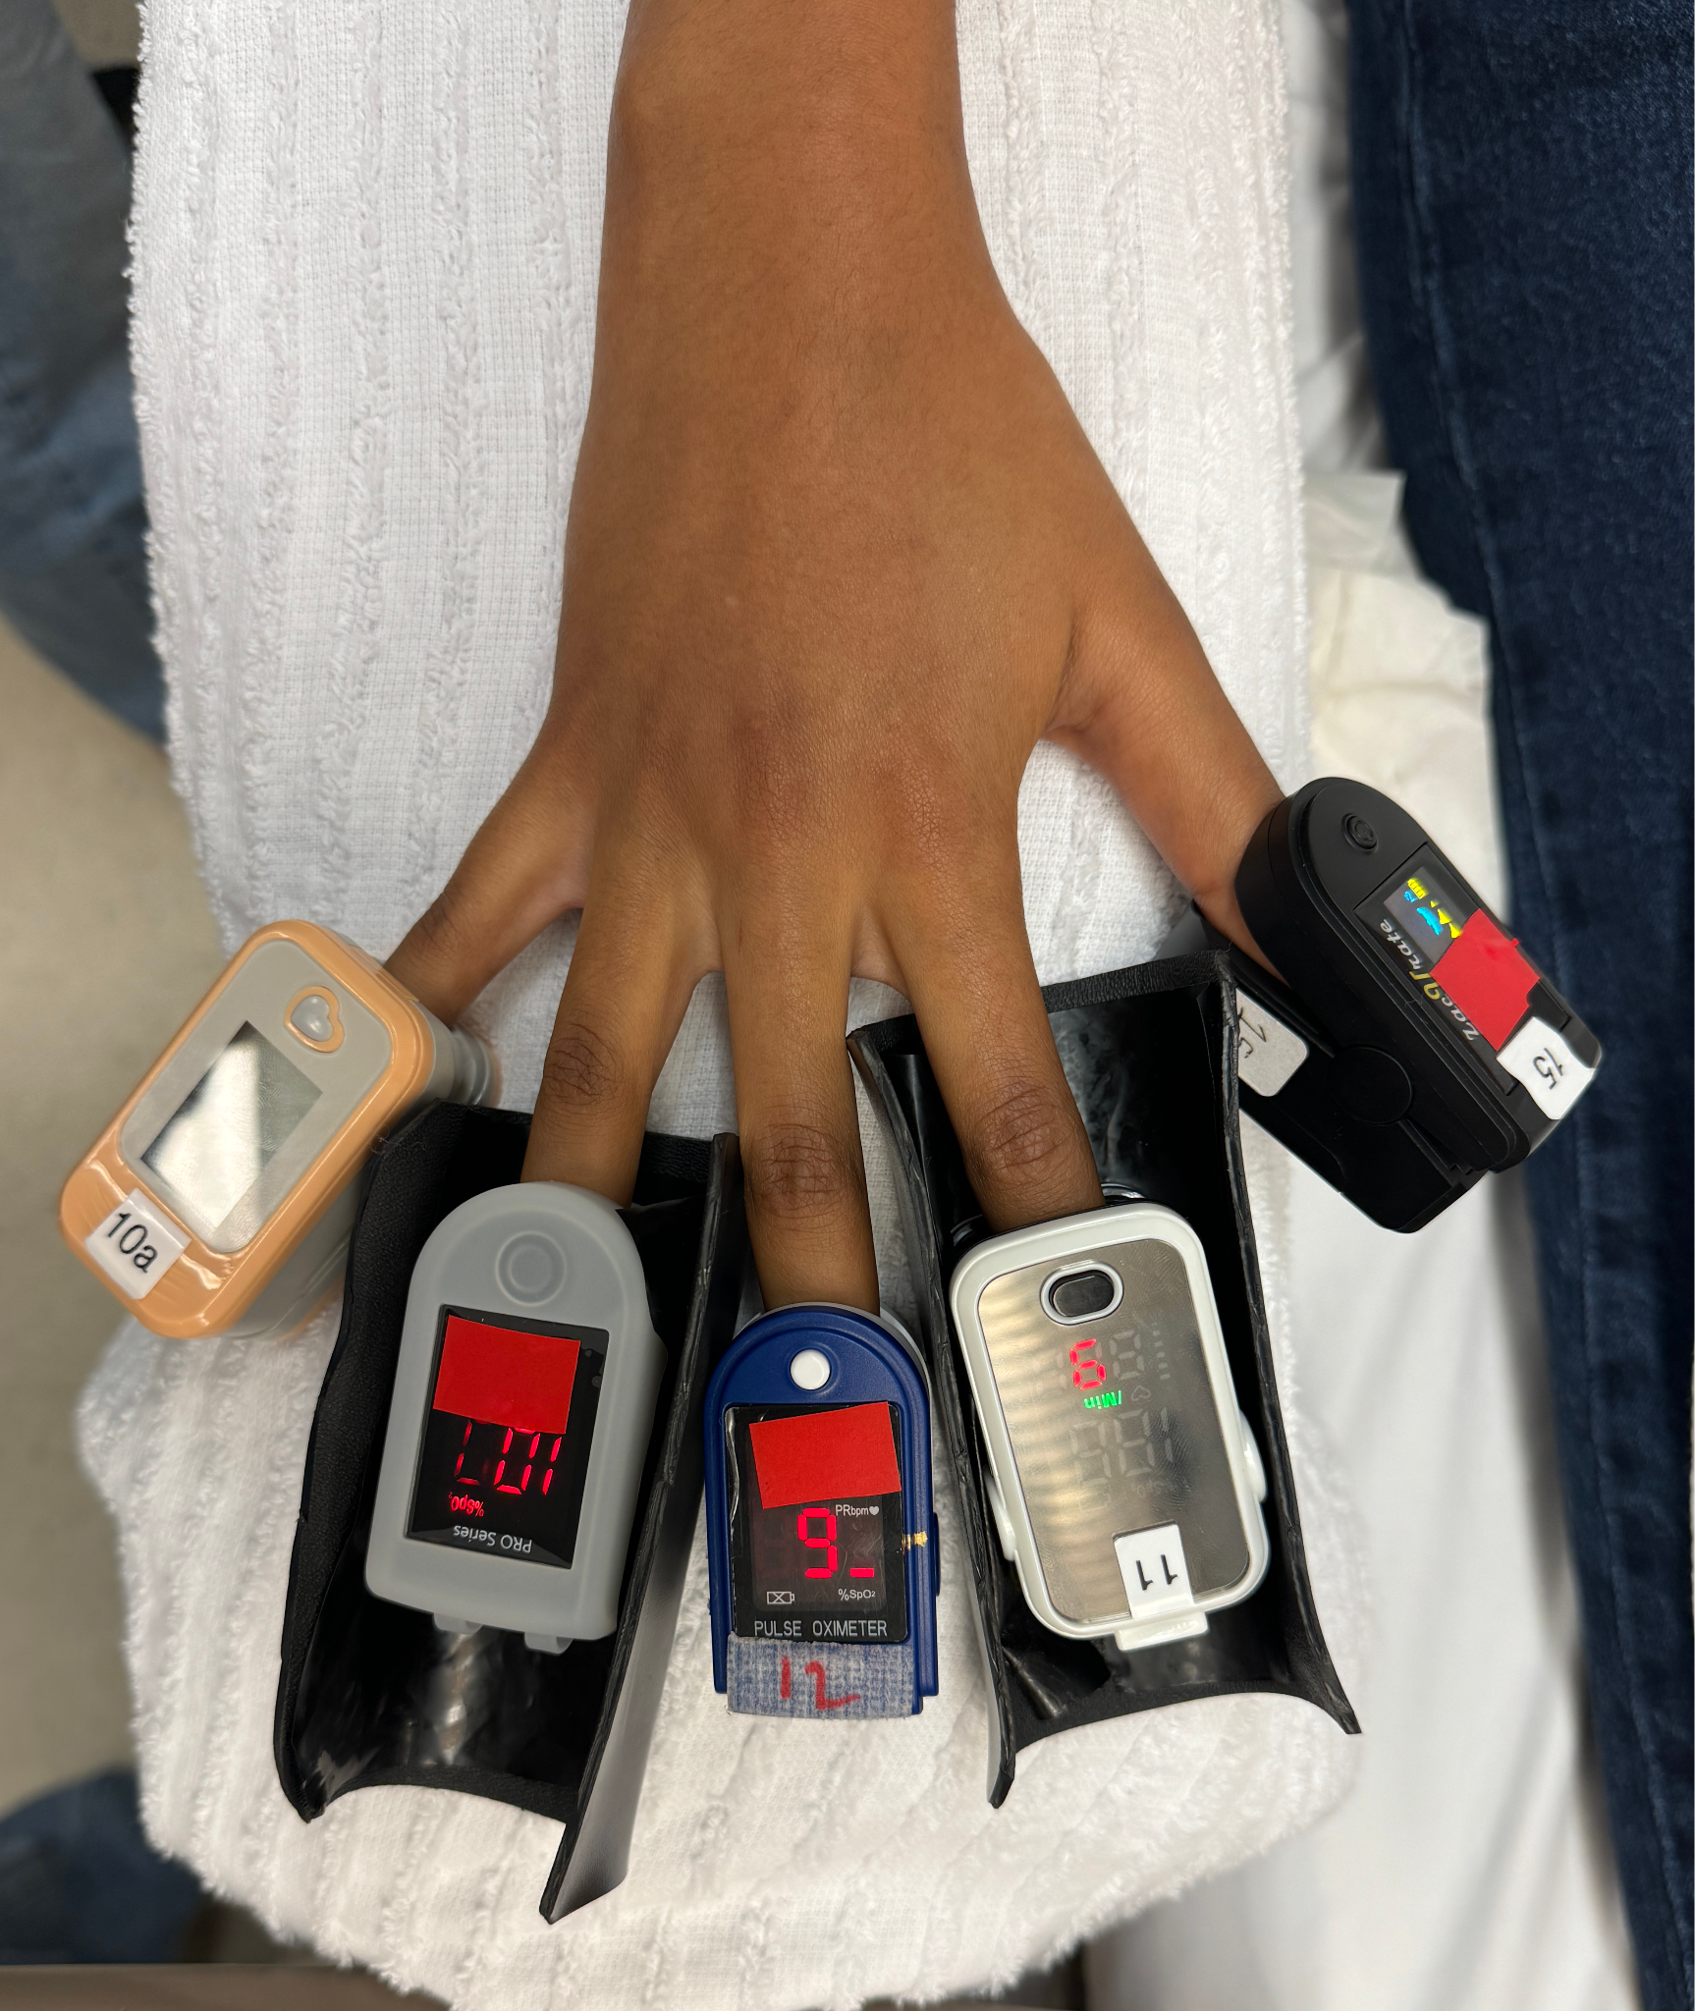
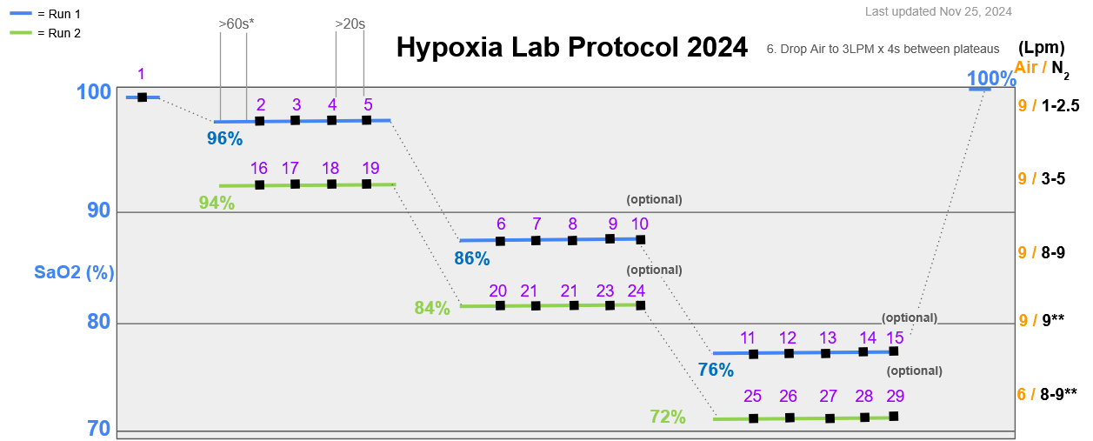
Data Collection
Method: controlled ‘breathe down’ desaturation protocol
Arterial catheter insertion
Patient given oxygen, carbon dioxide and nitrogen
SpO2, heart rate, blood pressure, respiratory rate recorded at various points
Five pulse ox place on fingers
Results in 100%-70% oxygenation level seen in PPG

Slide 10
Our Objectives
Given the base data, check for bias across different datasets
Utilize ML to develop a “more accurate” algorithm

Slide 11
Our Study
Experiment Outline, Hypothesis

Slide 12
Experiment Procedure
Data Compilation – join tables of important values
Comparing ground truth to predictors
Applying machine learning model to dataset
Examine if change in bias occurs

Slide 13
Data Compilation - Sample
encounter_id | date | time | sample | so2 | pulseoximeter.saturation | patient.assigned_sex | patient.race
01a542fef90c977867f1016bb46772e233006183c5c879b4c3adb77445aa1969 | 10/3/2218 | 2:24:00 PM | 1 | 98.4 | 97 | Male | Asian
01a542fef90c977867f1016bb46772e233006183c5c879b4c3adb77445aa1969 | 10/3/2218 | 2:24:00 PM | 1 | 98.4 | 97 | Male | Asian
01a542fef90c977867f1016bb46772e233006183c5c879b4c3adb77445aa1969 | 10/3/2218 | 2:24:00 PM | 1 | 98.4 | 98 | Male | Asian
01a542fef90c977867f1016bb46772e233006183c5c879b4c3adb77445aa1969 | 10/3/2218 | 2:24:00 PM | 1 | 98.4 | 99 | Male | Asian
01a542fef90c977867f1016bb46772e233006183c5c879b4c3adb77445aa1969 | 10/3/2218 | 2:24:00 PM | 1 | 98.4 | 98 | Male | Asian
01a542fef90c977867f1016bb46772e233006183c5c879b4c3adb77445aa1969 | 10/3/2218 | 2:24:00 PM | 1 | 98.4 | 99 | Male | Asian
01a542fef90c977867f1016bb46772e233006183c5c879b4c3adb77445aa1969 | 10/3/2218 | 2:24:00 PM | 1 | 98.4 | 99 | Male | Asian
01a542fef90c977867f1016bb46772e233006183c5c879b4c3adb77445aa1969 | 10/3/2218 | 2:28:00 PM | 1 | 98.6 | 97 | Male | Asian
01a542fef90c977867f1016bb46772e233006183c5c879b4c3adb77445aa1969 | 10/3/2218 | 2:28:00 PM | 1 | 98.6 | 97 | Male | Asian
01a542fef90c977867f1016bb46772e233006183c5c879b4c3adb77445aa1969 | 10/3/2218 | 2:28:00 PM | 1 | 98.6 | 98 | Male | Asian
01a542fef90c977867f1016bb46772e233006183c5c879b4c3adb77445aa1969 | 10/3/2218 | 2:28:00 PM | 1 | 98.6 | 99 | Male | Asian
01a542fef90c977867f1016bb46772e233006183c5c879b4c3adb77445aa1969 | 10/3/2218 | 2:28:00 PM | 1 | 98.6 | 98 | Male | Asian
01a542fef90c977867f1016bb46772e233006183c5c879b4c3adb77445aa1969 | 10/3/2218 | 2:28:00 PM | 1 | 98.6 | 99 | Male | Asian
01a542fef90c977867f1016bb46772e233006183c5c879b4c3adb77445aa1969 | 10/3/2218 | 2:28:00 PM | 1 | 98.6 | 99 | Male | Asian
01a542fef90c977867f1016bb46772e233006183c5c879b4c3adb77445aa1969 | 10/3/2218 | 2:28:00 PM | 2 | 93.7 | 93 | Male | Asian
01a542fef90c977867f1016bb46772e233006183c5c879b4c3adb77445aa1969 | 10/3/2218 | 2:28:00 PM | 2 | 93.7 | 92 | Male | Asian
01a542fef90c977867f1016bb46772e233006183c5c879b4c3adb77445aa1969 | 10/3/2218 | 2:28:00 PM | 2 | 93.7 | 94 | Male | Asian
01a542fef90c977867f1016bb46772e233006183c5c879b4c3adb77445aa1969 | 10/3/2218 | 2:28:00 PM | 2 | 93.7 | 94 | Male | Asian

Slide 14
Results

Slide 15
Conclusions

Slide 16

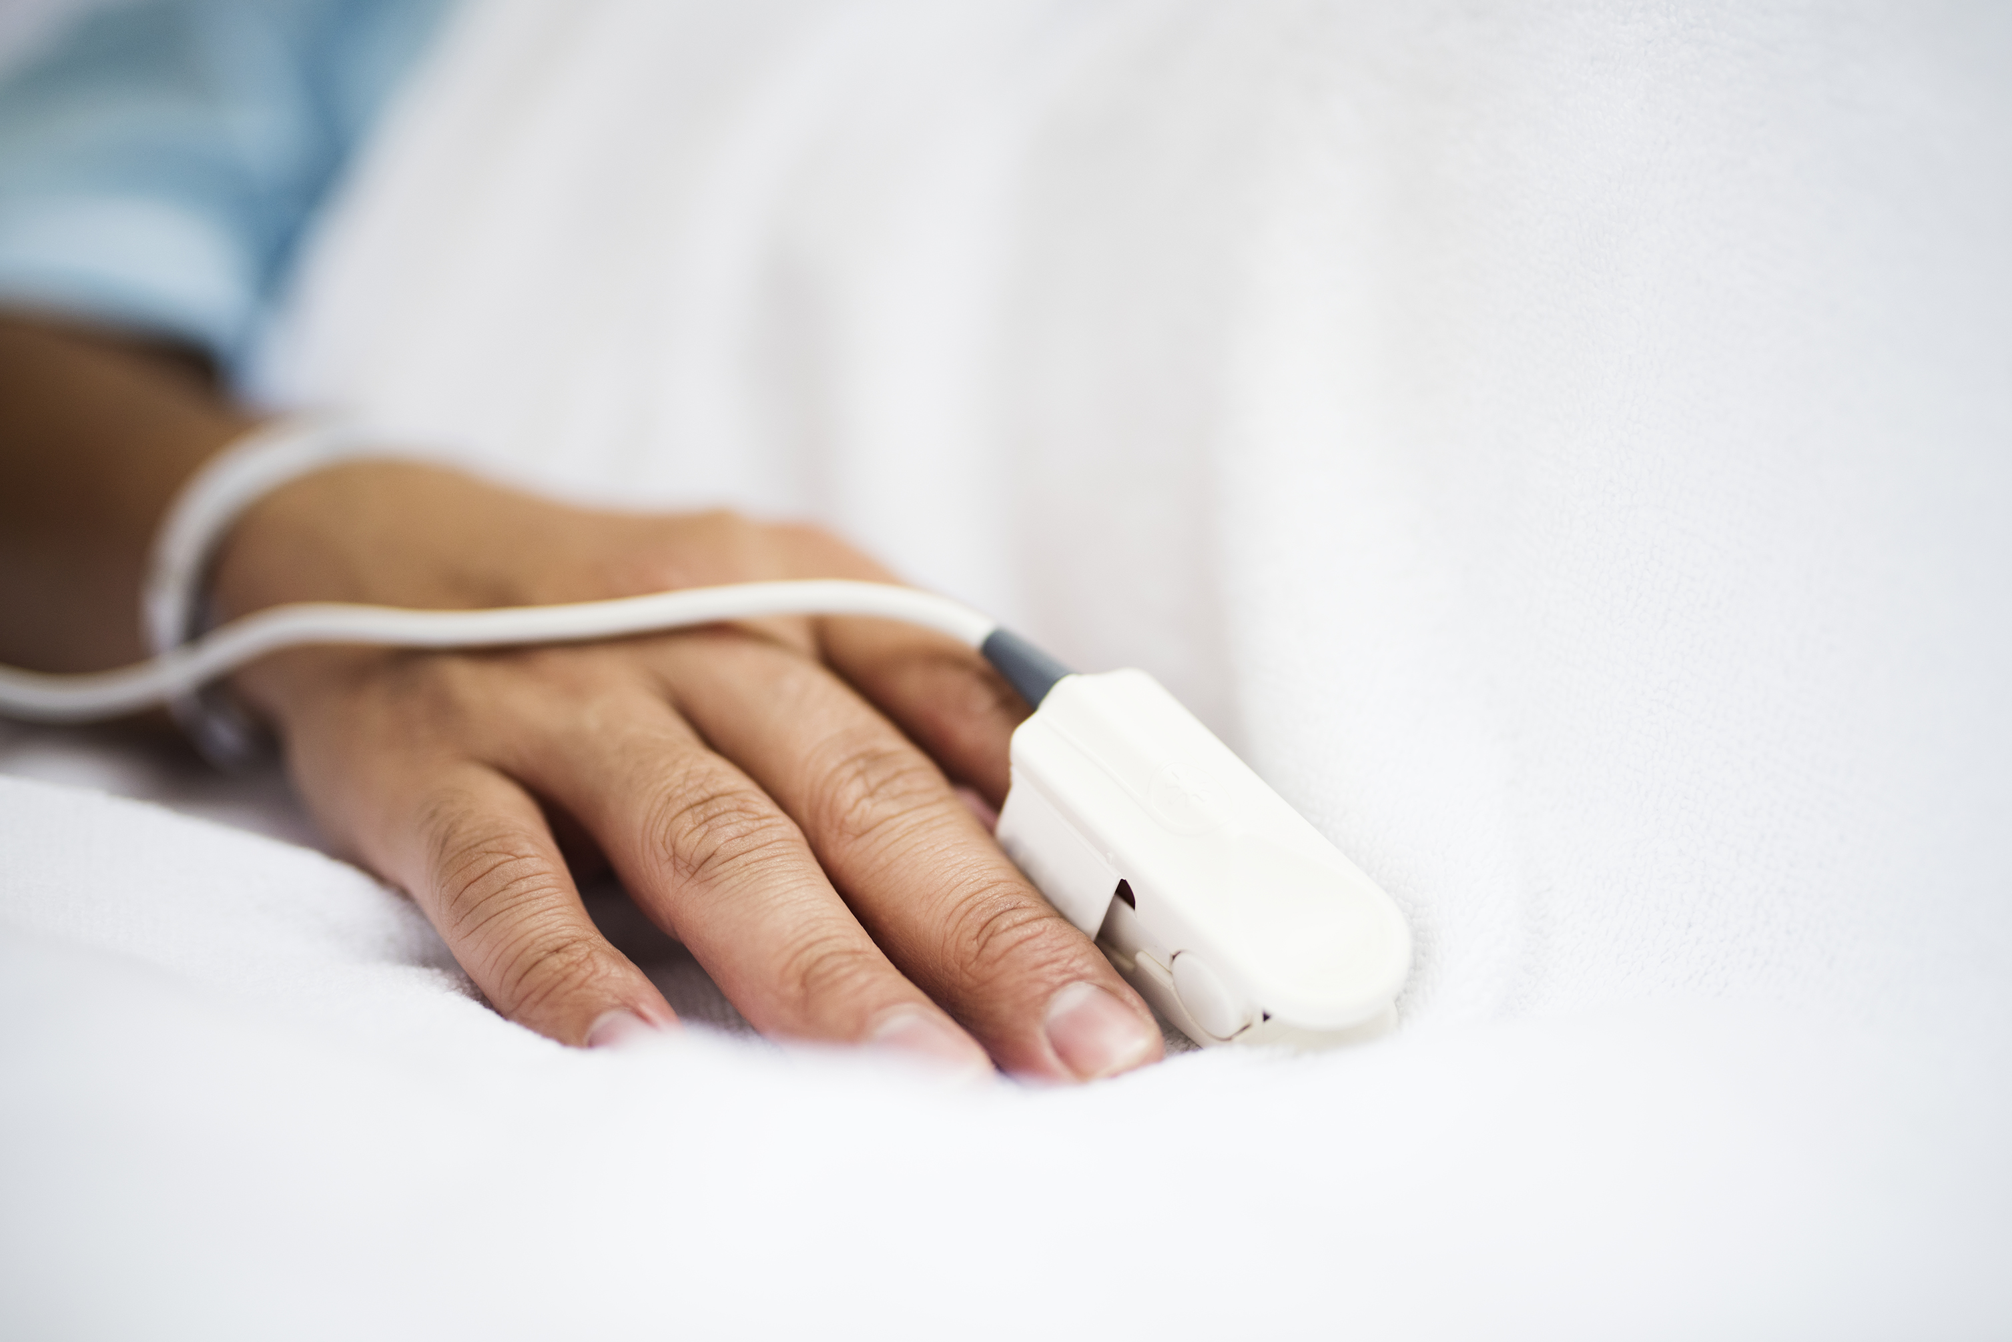


Slide 17
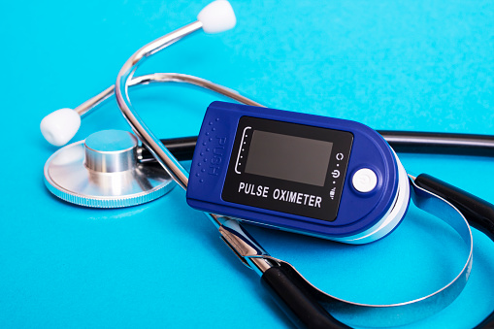
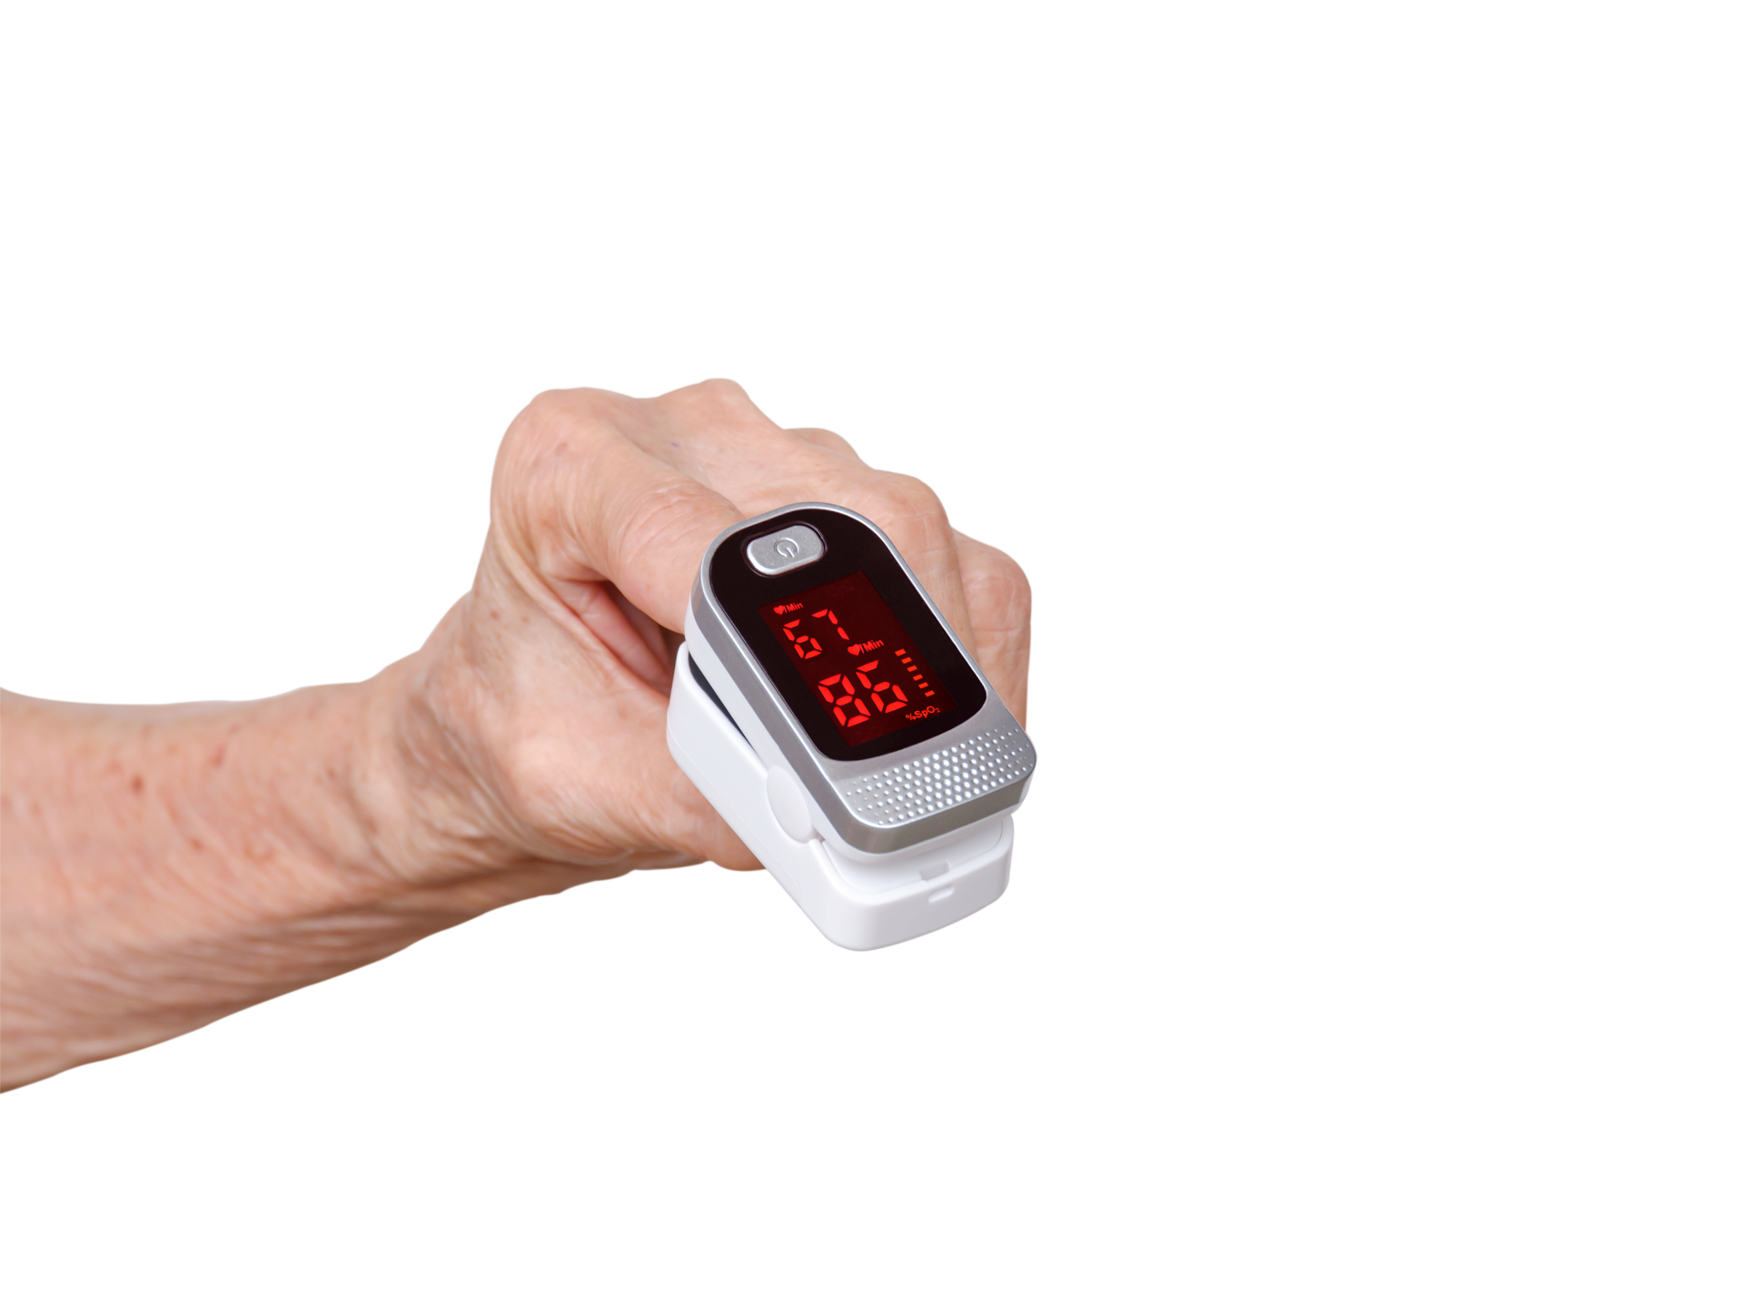
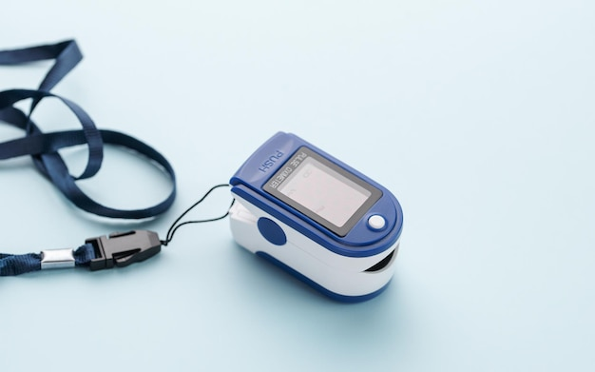
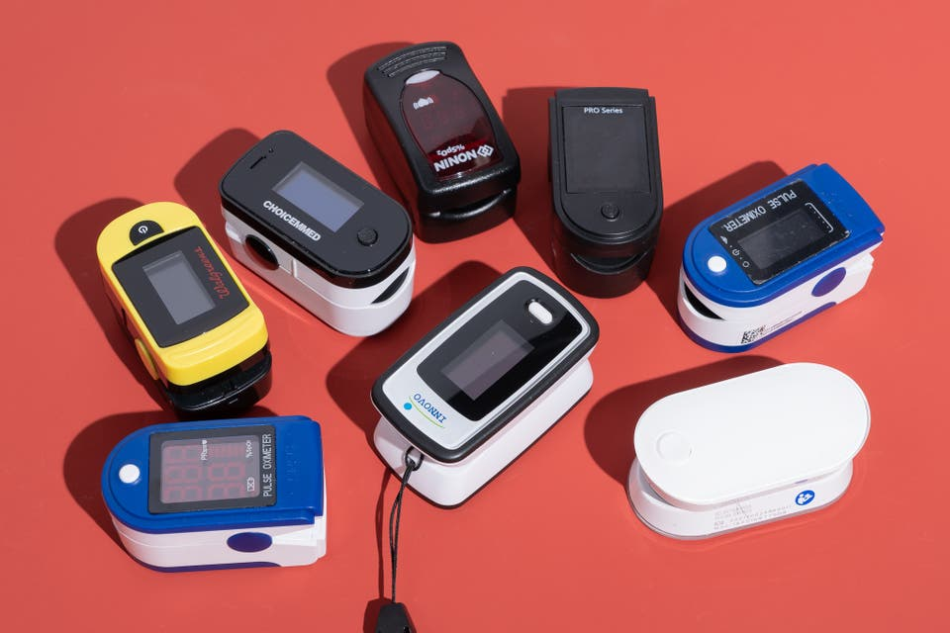
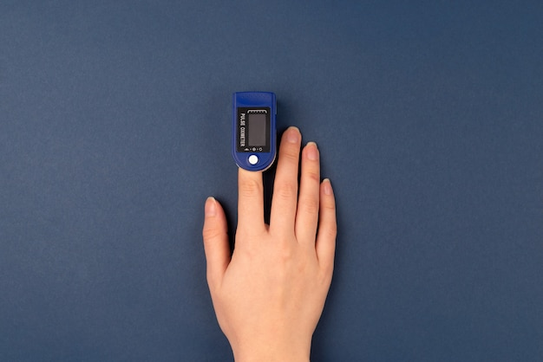

Slide 18


